Slide 1

Computer Organization & Assembly Language(CS-215T)
Lecture by:
Mr. Shakir Karim
Assistant Professor
DoCS&IT, SSUET
Batch 2022F

Slide 2
Topic
Basic Measures of Computer Performance
Computer Science & Information Technology Department
Sir Syed University of Engg. & Tech.
Lecture by: Mr. Shakir Karim

Slide 3
Contents To Be Covered
Hardware and Software Approach
Instruction Cycle
Basic Measures of Computer Performance
Performance Factors & System Attributes
Benchmarking
Computer Science & Information Technology Department
Sir Syed University of Engg. & Tech.
Lecture by: Mr. Shakir Karim

Slide 4
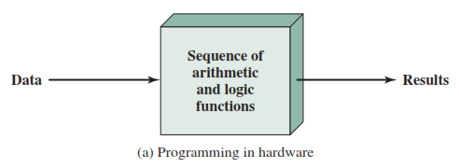
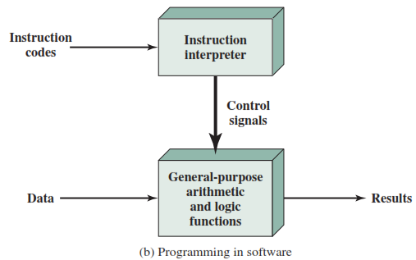
Hardware & Software Approach
Hardwired Program – Specialized hardware
Alternative is Software
Computer Science & Information Technology Department
Sir Syed University of Engg. & Tech.
Lecture by: Mr. Shakir Karim

Slide 5
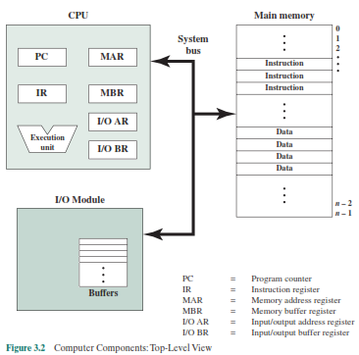
Computer Components
Computer Science & Information Technology Department
Sir Syed University of Engg. & Tech.
Lecture by: Mr. Shakir Karim

Slide 6
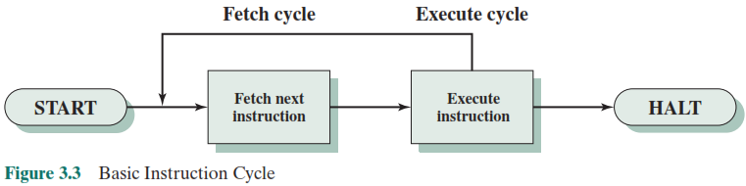
Instruction Cycle
The processing required for a single instruction is called an instruction cycle.
Instruction Fetch and Execute – Two Basic Steps for Instruction Cycle
Computer Science & Information Technology Department
Sir Syed University of Engg. & Tech.
Lecture by: Mr. Shakir Karim

Slide 7
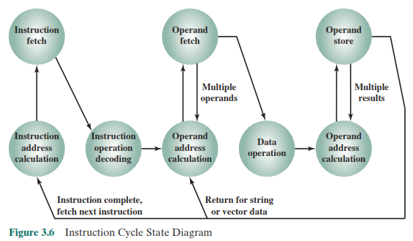
Instruction Cycle
State Diagram
Computer Science & Information Technology Department
Sir Syed University of Engg. & Tech.
Lecture by: Mr. Shakir Karim

Slide 8
An Example
Consider a computer in which each instruction occupies one 16-bit word of memory.
Assume that the program counter is set to
memory location 300,
Where,
the location address refers to a 16-bit word.
The processor will next fetch the instruction at
location 300.
On succeeding instruction cycles,
it will fetch instructions from locations
301, 302, 303
Computer Science & Information Technology Department
Sir Syed University of Engg. & Tech.
Lecture by: Mr. Shakir Karim

Slide 9




An Example
Computer Science & Information Technology Department
Sir Syed University of Engg. & Tech.
Lecture by: Mr. Shakir Karim

Slide 10
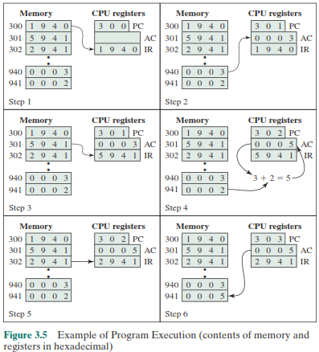
An Example
Computer Science & Information Technology Department
Sir Syed University of Engg. & Tech.
Lecture by: Mr. Shakir Karim

Slide 11
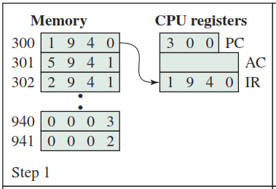
Fetching 1st Instruction into Instruction Register from Memory
Opcode = 1 = 0001
Means LOAD data from memory address 940 into Accumulator (ACC)
Computer Science & Information Technology Department
Sir Syed University of Engg. & Tech.
Lecture by: Mr. Shakir Karim

Slide 12
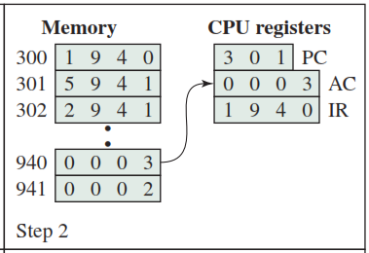
Fetching Data from Memory into Accumulator for 1st Instruction
Program Counter updated to get next instruction from Memory
LOADing data (0003) from memory address 940 Into Accumulator (ACC)
Computer Science & Information Technology Department
Sir Syed University of Engg. & Tech.
Lecture by: Mr. Shakir Karim

Slide 13
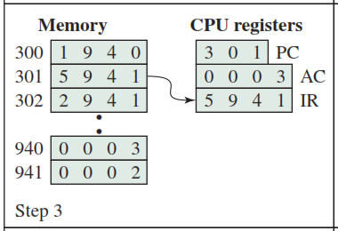
Fetching 2nd Instruction into Instruction Register from Memory
Opcode = 5 = 0101
Means ADD data in memory address 941 into Accumulator (ACC)
Computer Science & Information Technology Department
Sir Syed University of Engg. & Tech.
Lecture by: Mr. Shakir Karim

Slide 14
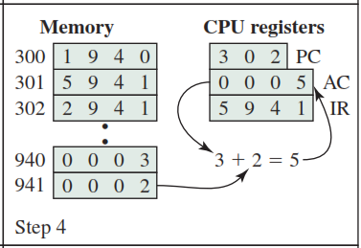
Executing 2nd Instruction
Program Counter updated to get next instruction from Memory
ACC = ACC + Data in Memory address 941
Computer Science & Information Technology Department
Sir Syed University of Engg. & Tech.
Lecture by: Mr. Shakir Karim

Slide 15
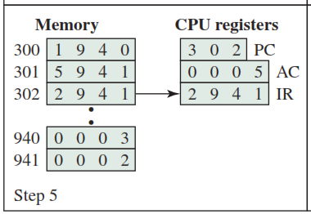
Fetching 3rd Instruction into Instruction Register from Memory
Opcode = 2 = 0010
Means STORE data from Accumulator (ACC) Into memory address 941
Computer Science & Information Technology Department
Sir Syed University of Engg. & Tech.
Lecture by: Mr. Shakir Karim

Slide 16
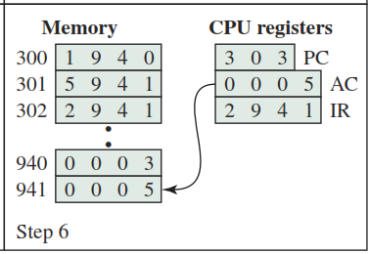
Executing 3rd Instruction
Program Counter updated to get next instruction from Memory
STORing data from ACC into Memory address 941
Computer Science & Information Technology Department
Sir Syed University of Engg. & Tech.
Lecture by: Mr. Shakir Karim

Slide 17
Basic Measures of Performance
meaningful performance comparisons among different processors – it’s difficult
However,
Application performance depends not just on the raw speed of the processor
But also on
the instruction set,
choice of implementation language,
efficiency of the compiler, and
skill of the programming done to implement the application.
Computer Science & Information Technology Department
Sir Syed University of Engg. & Tech.
Lecture by: Mr. Shakir Karim

Slide 18
Basic Measures of Performance
Clock Speed – the rate of pulses (aka clock rate)
Governs operations performed by the computer
the speed of a processor – the pulse frequency produced by the clock,
Measured in cycles per second or Hertz (Hz) generated by quartz crystal
Computer Science & Information Technology Department
Sir Syed University of Engg. & Tech.
Lecture by: Mr. Shakir Karim

Slide 19
Basic Measures of Performance
Instruction Execution Rate
A processor is driven by a clock
with a constant frequency f or,
a constant cycle time τ, where τ = 1/ f.
Consider the instruction count, Ic, for a program
as the number of machine instructions executed
for that program until it runs to completion or for
some defined time interval.
Instruction count is the number of instruction execution not the instruction code.
Computer Science & Information Technology Department
Sir Syed University of Engg. & Tech.
Lecture by: Mr. Shakir Karim

Slide 20

Basic Measures of Performance
Average Cycle per Instruction (CPI)
An important parameter for a program
the number of clock cycles required varies for different types of instructions,
such as load, store, branch.
Let
CPI_{i} be the number of cycles required for instruction type i,
I_{c} be the number of executed instructions of type i for a given program.
Then the overall CPI will be expressed as
Computer Science & Information Technology Department
Sir Syed University of Engg. & Tech.
Lecture by: Mr. Shakir Karim

Slide 21

Basic Measures of Performance
How to express the processor time T?
The processor time T needed to execute a given program can be expressed as
However,
During the execution of an instruction,
part of the work is done by the processor, and
part of the time a word is being transferred to or from memory.
Here, τ = 1/f
Computer Science & Information Technology Department
Sir Syed University of Engg. & Tech.
Lecture by: Mr. Shakir Karim

Slide 22

Performance Factors &
System Attributes
time to transfer depends on the memory cycle time,
which may be greater than the processor cycle time
We can rewrite the preceding equation as
Where,
p is the number of processor cycles needed to decode and execute the instruction,
m is the number of memory references needed, and
k is the ratio between memory cycle time and processor cycle time
Computer Science & Information Technology Department
Sir Syed University of Engg. & Tech.
Lecture by: Mr. Shakir Karim

Slide 23
Performance Factors &
System Attributes
The five performance factors (I_{c}, p, m, k, t) are influenced by four system attributes:
-the instruction set design (known as instruction set architecture);
-compiler technology (how effective the compiler is in producing an efficient machine language
-program from a high-level language program); processor implementation;
-cache and memory hierarchy.
Computer Science & Information Technology Department
Sir Syed University of Engg. & Tech.
Lecture by: Mr. Shakir Karim

Slide 24
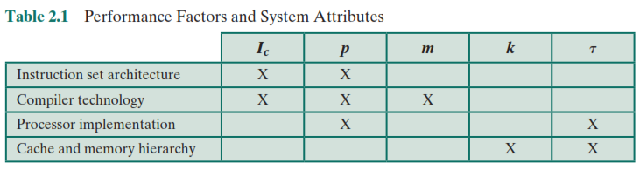
Performance Factors &
System Attributes
Computer Science & Information Technology Department
Sir Syed University of Engg. & Tech.
Lecture by: Mr. Shakir Karim

Slide 25
Making Things Simple
T – processor time required to execute a program that has been prepared in high-level language
N – number of actual machine language instructions needed to complete the execution (note: loop)
S – average number of basic steps needed to execute one machine instruction. Each step completes in one clock cycle
R – clock rate
Note: these are not independent to each other
How to improve T?
Reduce N and S, Increase R,
but these affect one another
Computer Science & Information Technology Department
Sir Syed University of Engg. & Tech.
Lecture by: Mr. Shakir Karim

Slide 26
Making Things Simple
Increase clock rate
Improve the integrated-circuit (IC) technology to make the circuits faster
Reduce the amount of processing done in one basic step
however,
this may increase the number of basic steps needed
Increases in R that are entirely caused by improvements in IC technology affect all aspects of the processor’s operation equally except the time to access the main memory.
Computer Science & Information Technology Department
Sir Syed University of Engg. & Tech.
Lecture by: Mr. Shakir Karim

Slide 27
Making Things Simple
Tradeoff between N and S
A key consideration is the use of pipelining
  S is close to 1 even though the number of basic steps per instruction may be considerably larger
  It is much easier to implement efficient pipelining in processor with simple instruction sets
Reduced Instruction Set Computers (RISC)
(Large value N , Small Value of S)
Complex Instruction Set Computers (CISC)
(Small value N , Large Value of S)
Computer Science & Information Technology Department
Sir Syed University of Engg. & Tech.
Lecture by: Mr. Shakir Karim

Slide 28

Common Measure For
Processor Performance
The common measure for Processor performance is MIPS rate
It is the rate at which instructions are executed.
Connecting to the previous measures!
Expressing MIPS rate in terms of clock rate and CPI as
Computer Science & Information Technology Department
Sir Syed University of Engg. & Tech.
Lecture by: Mr. Shakir Karim

Slide 29
Common Measure For
Processor Performance
Another common measure for Processor performance is MFLOPS rate
It deals only with floating-point instructions.
Common in many scientific and game applications.
Computer Science & Information Technology Department
Sir Syed University of Engg. & Tech.
Lecture by: Mr. Shakir Karim

Slide 30
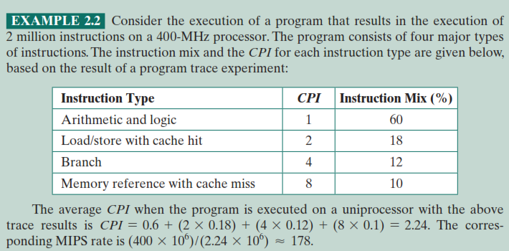
Example
Computer Science & Information Technology Department
Sir Syed University of Engg. & Tech.
Lecture by: Mr. Shakir Karim

Slide 31
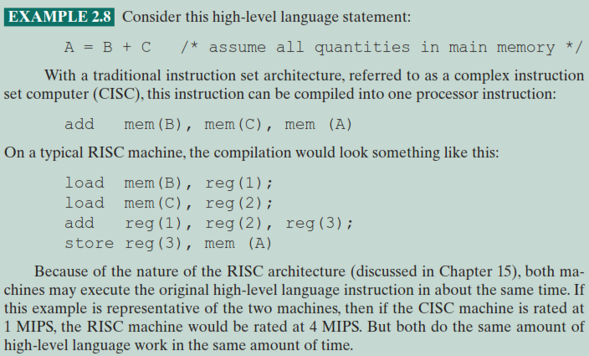
Are These Measures Adequate?
Computer Science & Information Technology Department
Sir Syed University of Engg. & Tech.
Lecture by: Mr. Shakir Karim

Slide 32
Are These Measures Adequate?
Measures such as MIPS and MFLOPS have proven inadequate to evaluating the performance of processors. Because of differences
in instruction sets, the instruction execution rate is not a valid means of comparing the performance of different architectures.
Computer Science & Information Technology Department
Sir Syed University of Engg. & Tech.
Lecture by: Mr. Shakir Karim

Slide 33
Benchmarking
T is difficult to compute.
Measure computer performance using benchmark programs.
System Performance Evaluation Corporation (SPEC) selects and publishes representative application programs for different application domains, together with test results for many commercially available computers.
Compile and run (no simulation)
Reference computer
n is the number of program in the suite
Computer Science & Information Technology Department
Sir Syed University of Engg. & Tech.
Lecture by: Mr. Shakir Karim

